Slide 1
Are You Paying Attention?
Driver Distraction Detection
A comparative study on various machine learning and deep learning techniques for the classification problem of driver distraction.
Presented by: GROUP C
Maitree Leekha, Devika Vijay, Megha Roshan, Harshinee Sriram,
Apurva Surya, Rohan Rao

Slide 2
Introduction
We've all been there: a light turns green and the car in front of you doesn't budge. Or, a previously unremarkable vehicle suddenly slows and starts swerving from side-to-side.
When you pass the offending driver, what do you expect to see? You certainly aren't surprised when you spot a driver who is texting, seemingly enraptured by social media, or in a lively hand-held conversation on their phone.
According to the CDC motor vehicle safety division, one in five car accidents is caused by a distracted driver. Sadly, this translates to 425,000 people injured and 3,000 people killed by distracted driving every year.
The idea hopes to improve these alarming statistics, and better insure their customers, by testing whether dashboard cameras can automatically detect drivers engaging in distracted behaviors.

Slide 3
Having introduced the idea, we now proceed with the detailed implementation of the project, which has been divided into the following phases:
Data Understanding- A brief description about the dataset, source, etc.
Data Preprocessing/Analysis- Preprocessing and extracting features from the data.
Modelling- A comparative study on the various machine learning and deep learning approaches used.
Evaluation- Assessing the performance of the model based on various classification accuracy metrics
Comparison- A comparative analysis to find the best model over various parameter.
Further, possible deployment strategies and applications have been discussed.

Slide 4
Data Understanding

Slide 5
The data set we have used for our project has been taken from a Kaggle Challenge for Distracted Driver Detection by State Farm.
In this competition, we are given driver images, each taken in a car with a driver doing something in the car (texting, eating, talking on the phone, makeup, reaching behind, etc). The goal of this computer vision is to predict the likelihood of what the driver is doing in each picture.
The 10 classes predicted are:
c0 | Safe Driving | c5 | Operating Radio
c1 | Texting-Right | c6 | Drinking
c2 | Talking On Phone - Right | c7 | Reaching Behind
c3 | Texting-Left | c8 | Hair and Makeup
c4 | Talking On Phone -Left | c9 | Talking to Passenger

Slide 6
The dataset has a set of labelled images for training, and a set of unlabeled images for testing and submitting.
For our project, we have used only the training dataset of labeled images for both training our models and evaluating them.
The training set was balanced with around 2200 images for all the 10 target classes. Thus, the distribution of the target class was symmetric. (not skewed)
The total number of labelled images was 22,414.
All the images were of the same size – 480x480 pixels. But in order to reduce the number of pixels, they were resized to 100x100 pixels.
Some images from the dataset have been shown here:

Slide 7
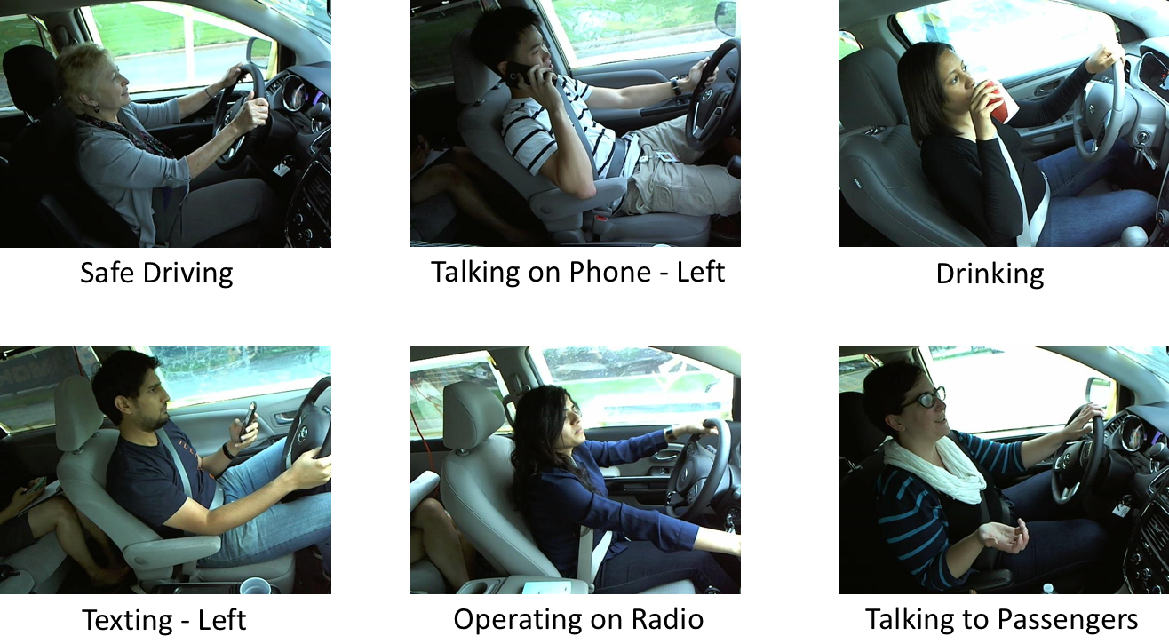

Slide 8
Data Preprocessing

Slide 9
Considering the task on hand, we intuitively thought that not all the pixel values contributed equal weights to the class value assigned to a particular image.
Consider the two images below:
We can clearly see that it is mostly the positioning of the hands of the driver that contributes the most to the classification. In some cases, say if the driver is talking to the passenger or is reaching behind, the position of the face may also be useful.

Slide 10
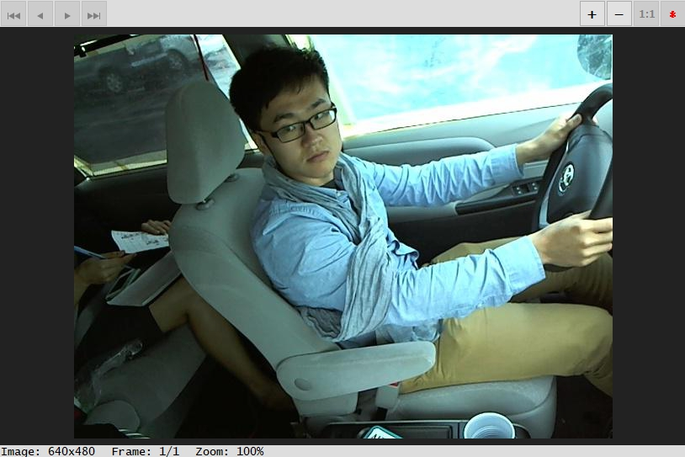
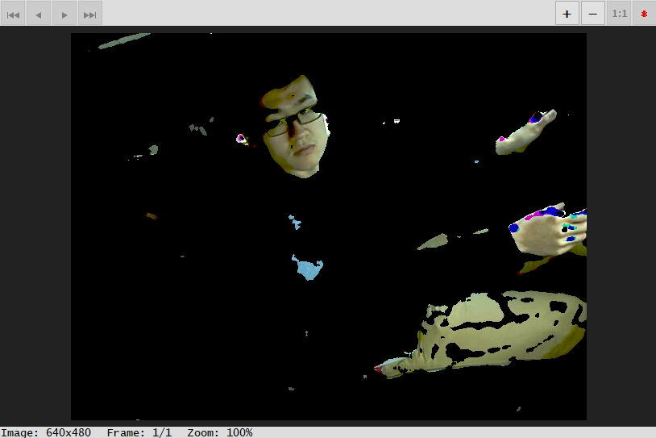
On these grounds, we found it safe to preprocess the images to remove the background noise which barely contributed as a prominent feature.
We wrote an R script to reduce all the background pixels to black by using filters.
We found a list of possible skin colors and then used the dplyr and EBImage R libraries to create filters for the same. This was followed by some smoothening to make the adjacent pixel intensities similar.
Sample preprocessing:

Slide 11
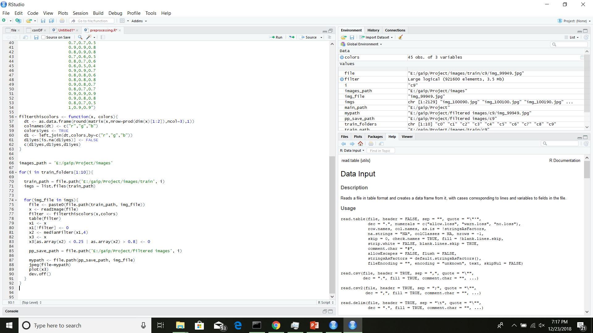
R Script:

Slide 12
Feature Extraction

Slide 13
Having done some preprocessing by removing the noisy background pixels, we did some feature extraction. Our images till now were encoded as 30,000 (100x100x3) pixel values. We could feed these values directly to the model, but training these models would have taken a lot of time as the number of dimensions is too large.
We thus performed feature extraction. For this we used Convolutional layers, which are widely used for extracting features out of the images.
Our convolutional network for feature extraction is the VGG16 model that is pre-trained on the ImageNet Dataset. We feed-forward our images through this network to get the features.
This extraction reduced our dimension to 4,068 which is a huge drop from a previous of 30,000 dimensions.

Slide 14
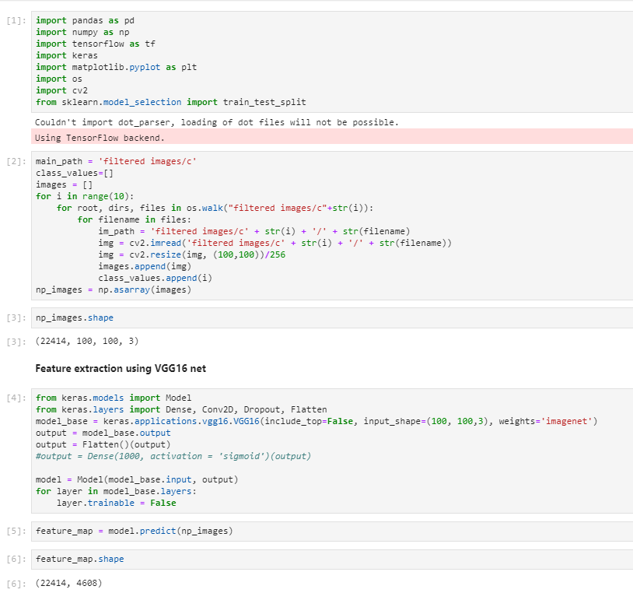
Python Script

Slide 15
Modelling

Slide 16
We have performed a comparative analysis on various modelling techniques, including machine learning and deep learning architectures to find the best model for the problem. The models we have used are as follows:
K-Nearest Neighbor Classifier
Support Vector Classifier
CNN models
CNN from scratch
Transfer Learning on VGG16 network
LSTM model
Each of these techniques has been discussed in detail below:

Slide 17
K-Nearest Neighbor Classifier

Slide 18
Theoretical Idea for the KNN Algorithm
KNN is a classical machine learning approach for classification problems. It is a lazy learning technique which defers all the computations until test time. So ideally, the training time for such a classifiers is zero. Isn’t that great? NO!
When a test data point is presented to the classifier, it calculates the ‘distance’ of that point from all the available training data points, takes the ‘K’ closest data points as the nearest neighbors who get to vote for what class will be assigned to this test data point.
A majority (may be weighted, etc.) vote is generally taken out of all the neighbors and that majority class is assigned to this test point.
The ‘distance’ measure can be numerical measure or any other proximity measure.
‘K’ must be predefined. Generally odd to break the ties.
This classifier takes a lot of time to classify the test data and is not a feasible option for real time deployment.

Slide 19
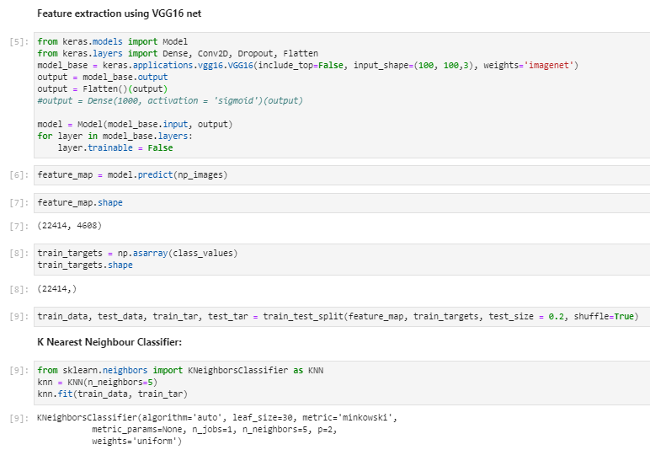
Input Data and Model Description
For this model, we have used the feature extracted data from the vgg16 convolutions, which reduced the output dimensions to 4608 from a previous of 30000 (100x100x3).
So, we have a dataset of the shape (22414, 4608).
For the model, we have set the ‘K’ hyperparameter i.e. the number of nearest neighbors taking part in the classification decision as 5.
The model definition and fitting commands are shown.
We have used a test split of 20%.
The distance measure has been set to a default of Euclidian.

Slide 20
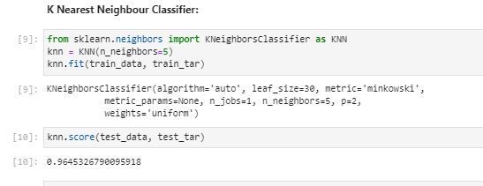
Model Evaluation
We evaluate our model on the 20% test set that was split in the beginning. We used the following evaluation metrics:
Test Set Accuracy
Confusion Matrix
Precision, Recall, F1 Score
ACCURACY: We got a 96.45% on the test set. (shown)
But this took a lott of time to score (TESTING). This is certainly a drawback.

Slide 21
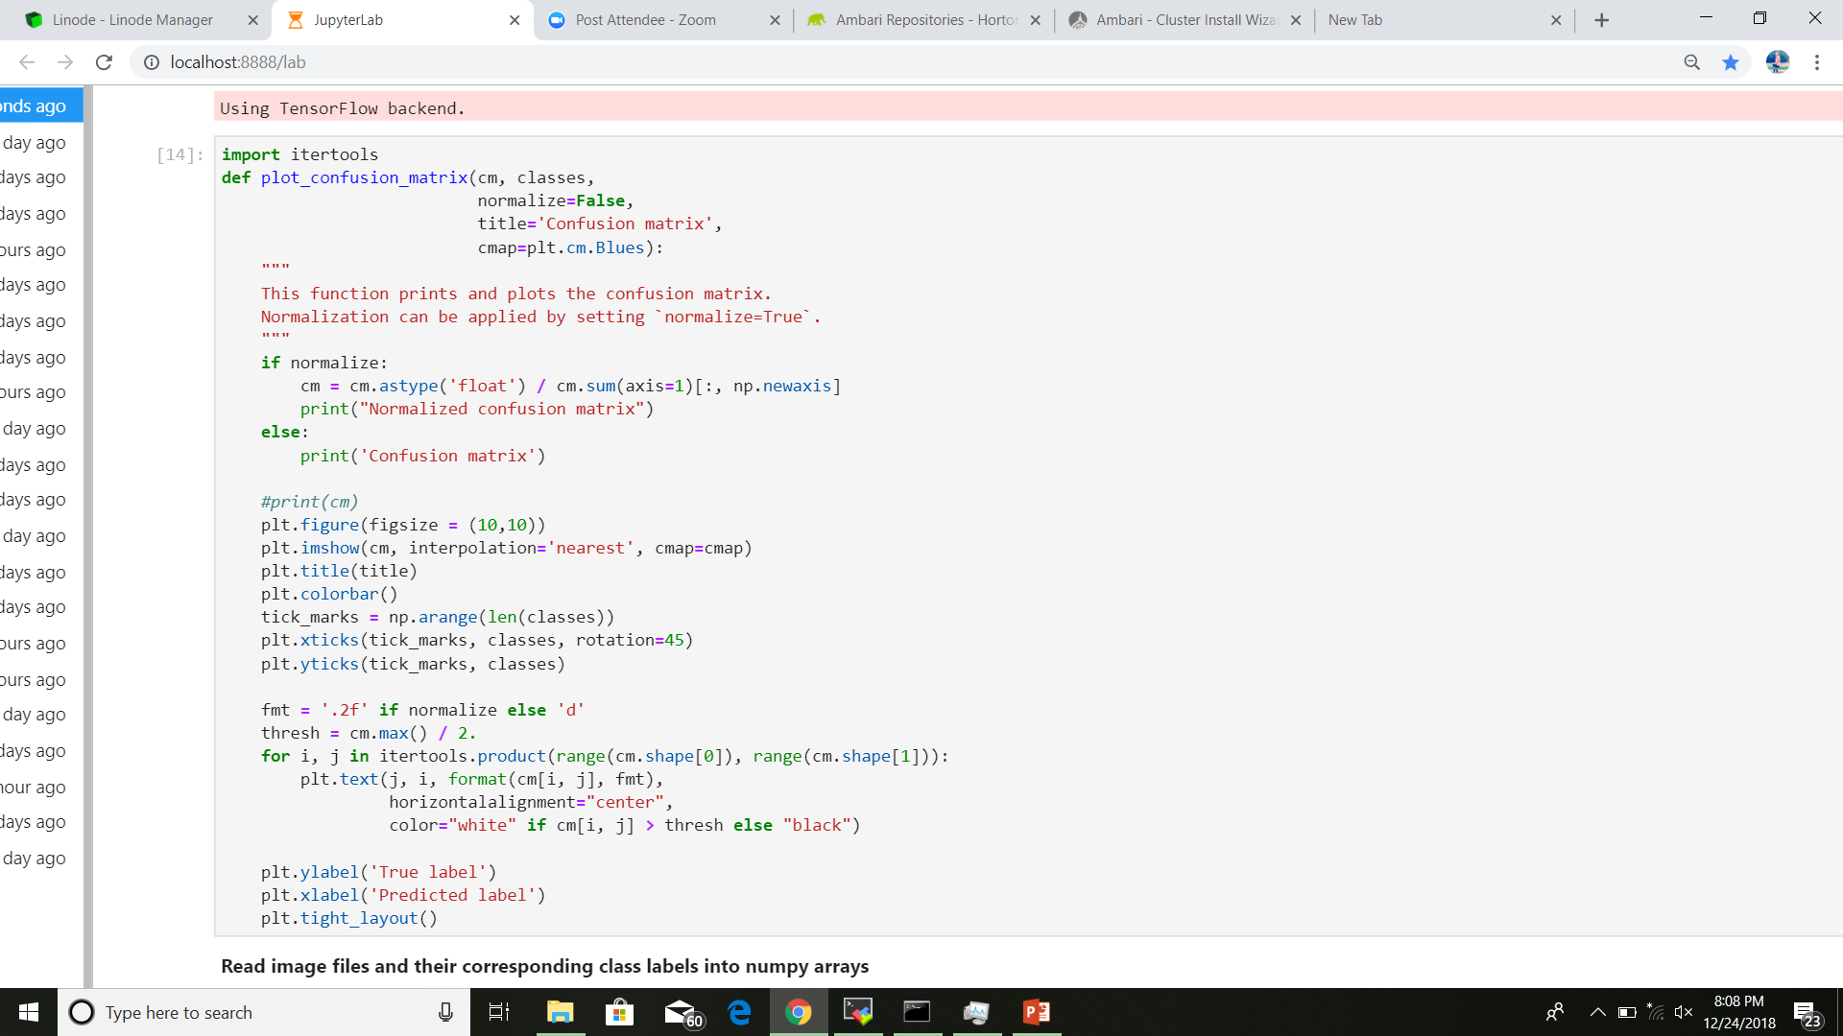
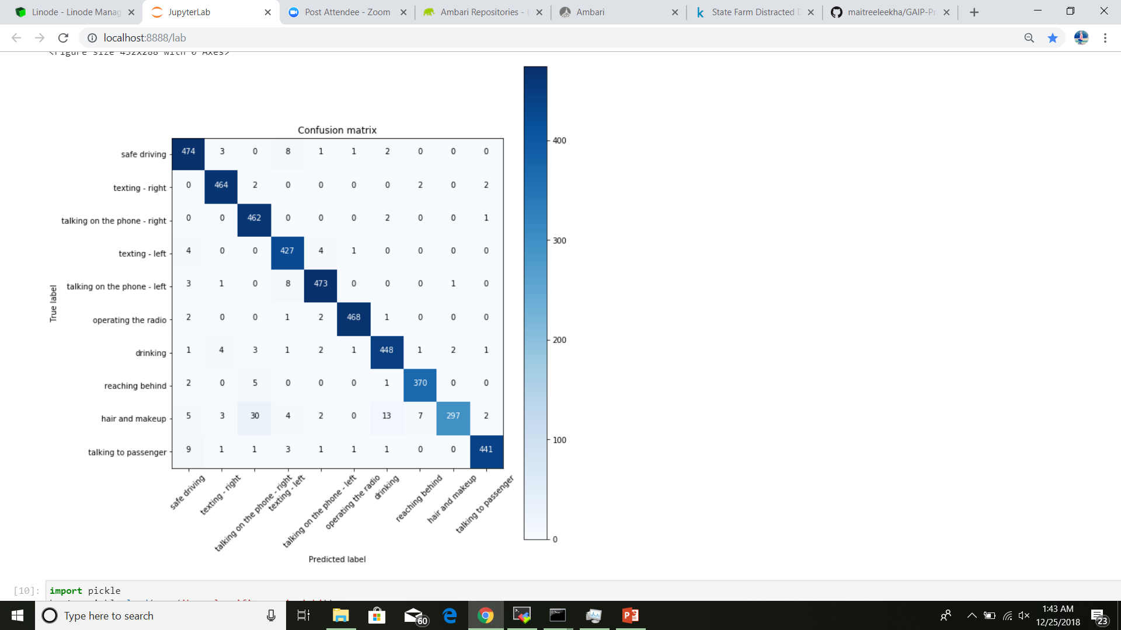
Model Evaluation (contd.)
CONFUSION MATRIX: The script and the confusion matrix are as below. As is evident from the diagonal entries of the matrix, most of the predictions done by the model are correct.

Slide 22
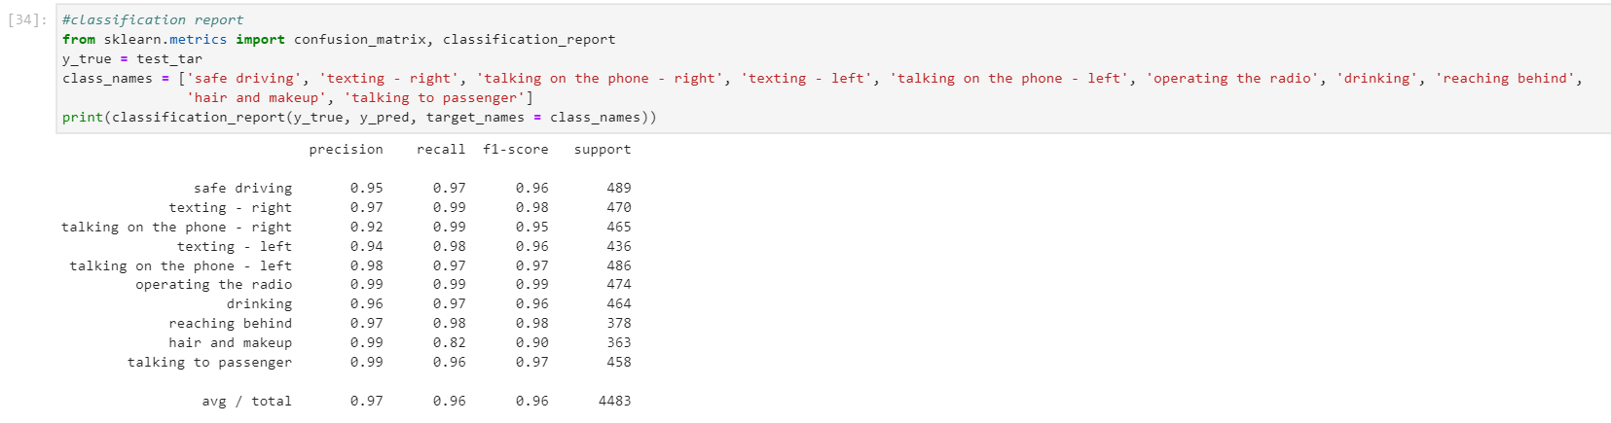
Model Evaluation (contd.)
CLASSIFICATION REPORT: For further insights about the model performance, we also found the precision, recall and F1 score for each target class. The script and the model performance as per the metrics is shown below. Average stats:
Precision: 0.97
Recall: 0.96
F1 Score: 0.96

Slide 23
Support Vector Classifier

Slide 24
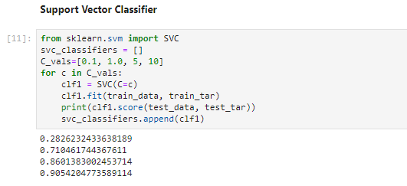
Input Data and Model Description
Support vector classifiers are separating classifiers which tend to create a boundary between the classes and this boundary must have the maximum margin from the support vectors.
This idea can be easily extended to the higher dimensions, using the kernel functions, as has been done in our case wherein the feature extracted data has 4608 dimensions.
The data used is the same as used by KNN (feature extracted using vgg16 net).
The model definition is shown.
We did hyper parameter tuning for the parameter C from the values [0.1, 1.0, 5.0, 10.0] by training different classifiers for each value and then choosing the one with the maximum score on the test set.
The best classifier is found to be one with C=10. Kernel function is set to default of radial bias function.

Slide 25
Model Evaluation
We evaluate our model on the 20% test set that was split in the beginning. We used the following evaluation metrics:
Test Set Accuracy
Confusion Matrix
Precision, Recall, F1 Score
ACCURACY: We got a 90.54% on the test set. (shown)
But this took a lot of time (for TRAINING) to score too. This is certainly a drawback.

Slide 26
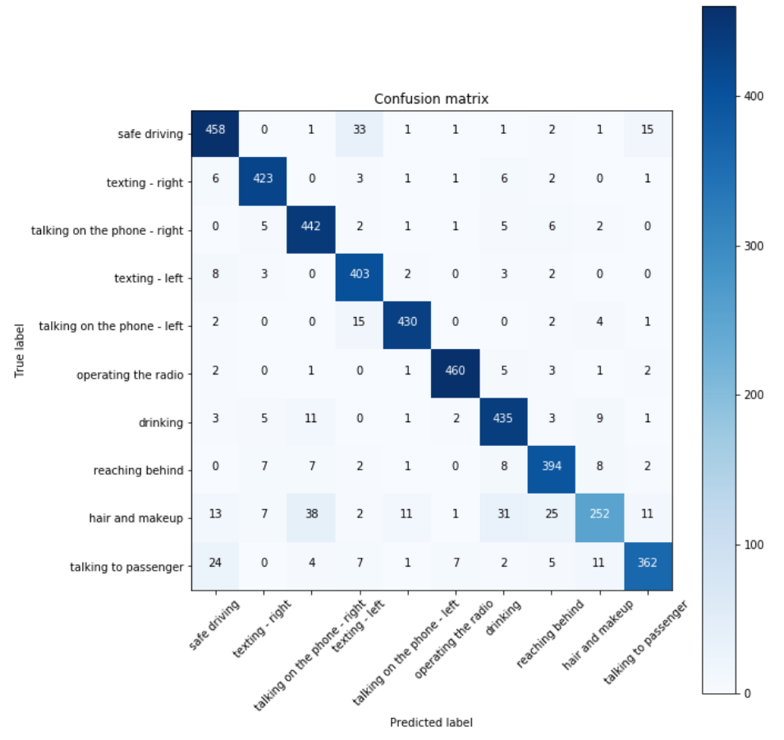
Model Evaluation (contd.)
CONFUSION MATRIX: The script and the confusion matrix are as below. As is evident from the diagonal entries of the matrix, most of the predictions done by the model are correct.

Slide 27
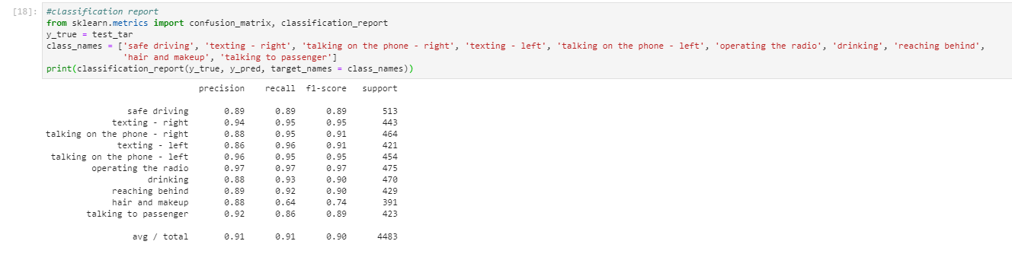
Model Evaluation (contd.)
CLASSIFICATION REPORT: For further insights about the model performance, we also found the precision, recall and F1 score for each target class. The script and the model performance as per the metrics is shown below. Average stats:
Precision: 0.91
Recall: 0.91
F1 Score: 0.90

Slide 28
Convolutional Neural Networks
CNN from scratch
Transfer learning on VGG16 (pretrained on ImageNet Dataset)

Slide 29
(A) CNN from scratch
Convolutional Neural Networks are known to perform extremely well for image datasets. They are used for a wide range of tasks, such as image classification, object detection, object recognition, belonging to a variety of fields, from medical sciences to aero-space.
For our custom-from-scratch CNN model, we used raw images as input to the model and observed the results over the training period.
The input shape here was (100, 100, 3).
The model was trained for 10 epochs.
Training this model took quite some time with ~10min/epoch on the train set.

Slide 30
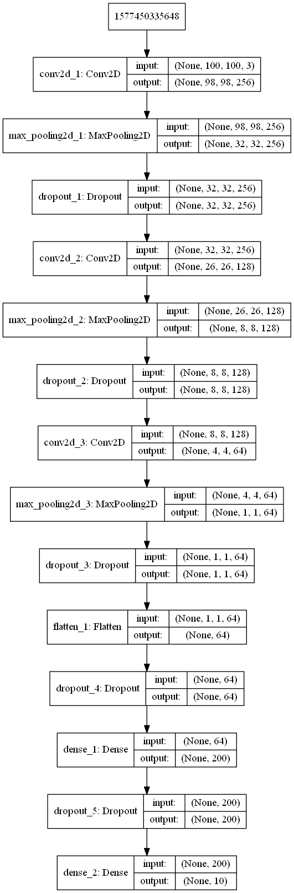
CNN-A Architecture (TODO)
The architecture used has 3 convolutional blocks of layers followed by fully connected layers for classification.
Each convolutional block consists of a Conv2D, MaxPooling2D and Dropout layer. Dropout layers are added as a measure to avoid overfitting, to meet the overall goal of generalization. Activation for the convolutional layers is ReLU.
The Dense layers then follow. The activation used is ReLU everywhere, except the last layer which uses softmax for classification output.

Slide 31
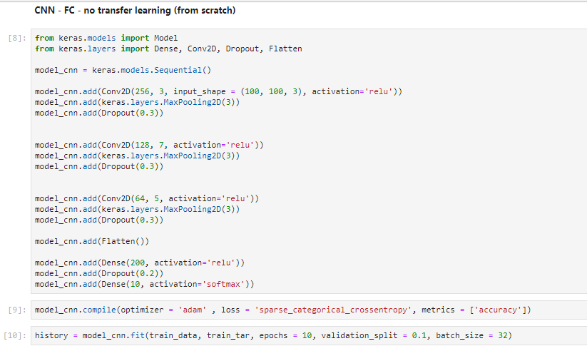
CNN-A Model Training
We split the data into train and test sets, with a test split of 30%.
The loss function minimized is the cross-entropy loss function.
The optimizer used Adam Optimizer, which is an improved version of Vanilla Gradient Descent algorithm, with added variations to overcome the affect of local minima.
While training, we look at the accuracy as a performance metric.
Also, we used 10% of our training set as validation set to see the generalized performance at the end of each epoch.
A batch size of 32 is used in our model.

Slide 32
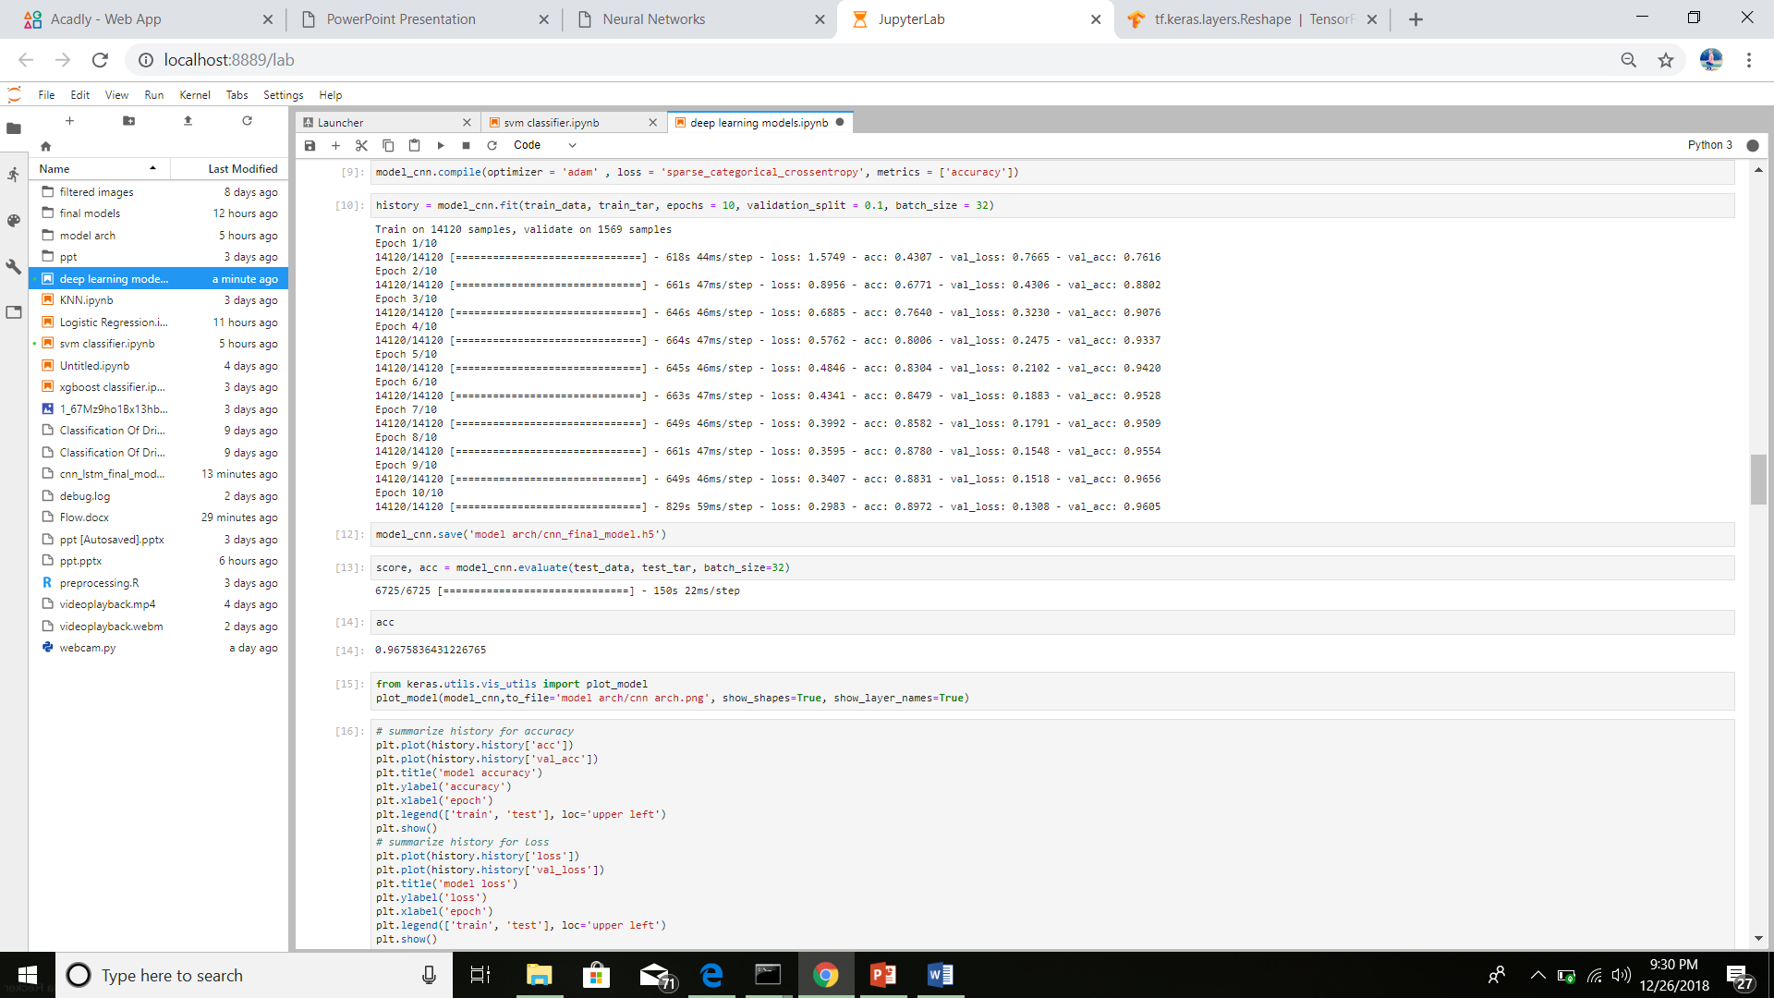
CNN-A Model Training (contd.)
We trained the model for 10 epochs.
Initial training accuracy: 0.4307
Final training accuracy: 0.8972

Slide 33
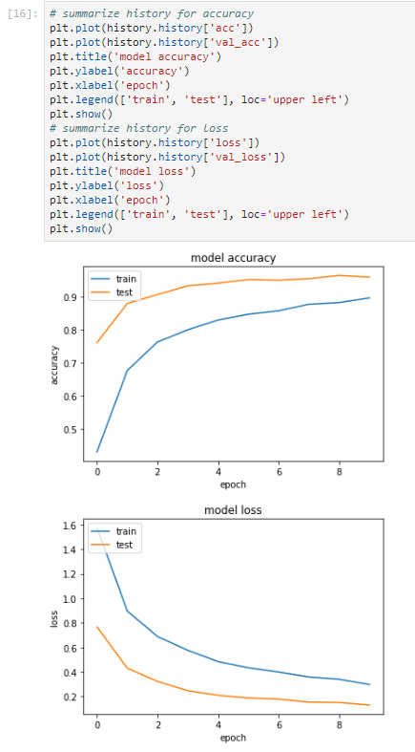
CNN-A Model Training (contd.)
The plots show the variation of accuracy and the loss function with each epoch for the training and the validation set.
The plots clearly show that the model performs very well on the validation set and thus has a higher generalization (test) accuracy and lower generalization loss . This is exactly what we want.

Slide 34
CNN-A Model Evaluation
We evaluate our model on the 30% test set that was split in the beginning. We used the following evaluation metrics:
Test Set Accuracy
Confusion Matrix
Precision, Recall, F1 Score
Area Under the ROC Curve
ACCURACY: We got a 96.75% on the test set. (shown)

Slide 35
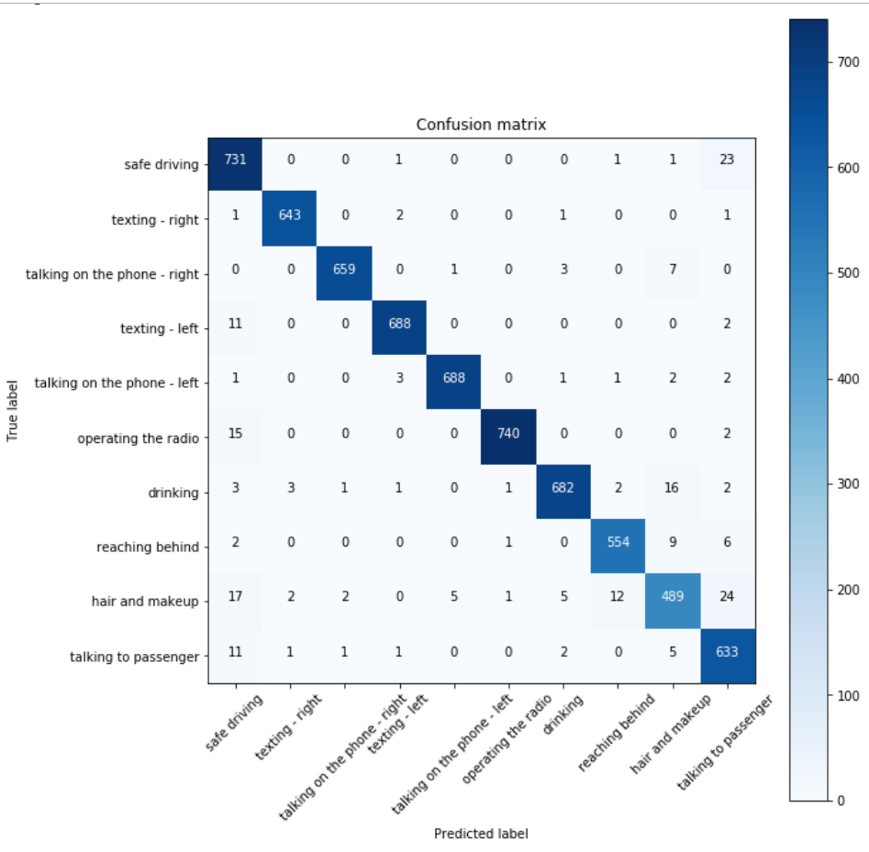
CNN-A Model Evaluation (contd.)
CONFUSION MATRIX: The script and the confusion matrix are as below. As is evident from the diagonal entries of the matrix, most of the predictions done by the model are correct.

Slide 36
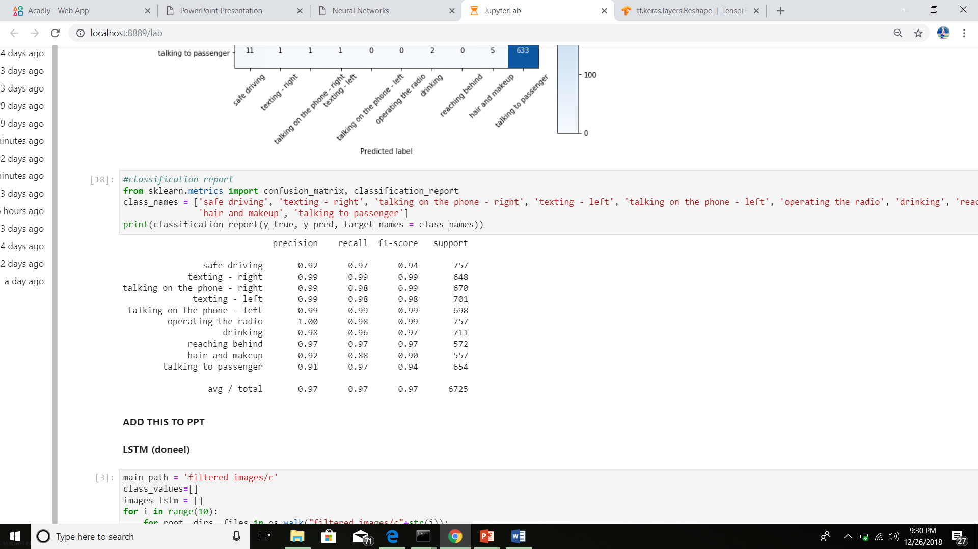
CNN-A Model Evaluation (contd.)
CLASSIFICATION REPORT: For further insights about the model performance, we also found the precision, recall and F1 score for each target class. The script and the model performance as per the metrics is shown below. The model performs pretty good as per the report ☺. Average stats:
Precision: 0.97
Recall: 0.97
F1 Score: 0.97

Slide 37
(B) CNN: Transfer Learning on VGG16
For this variant of the convolutional network frameworks, we resort to transfer learning. We use a pretrained VGG16 network, which was trained on the IMAGENET Dataset. It was available as a ready to use application in the keras library.
VGG16 was a break through architecture when it was first introduced in the ImageNet competition. Many more sophisticated networks have evolved since, which have even more accuracy than vgg16, still vgg16 is widely used. The detailed architecture used is discussed later.
The input shape for the model was (100, 100, 3) since we used raw images.
We trained the model for 8 epochs.
Training took quite a while with ~10min/epoch.

Slide 38
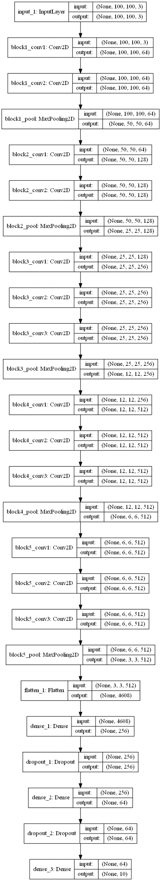
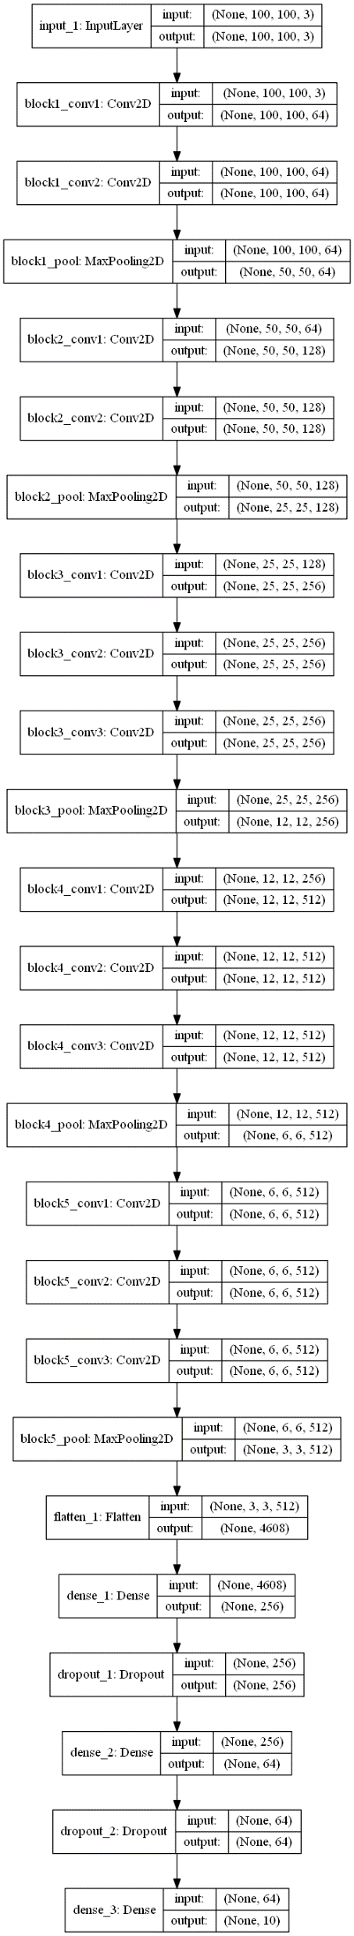
CNN-B Architecture
We have used the convolutional blocks exactly as in the VGG16 network.
We added our own dense layers at the end. The number of fully connected layers are 3, each with sigmoid non linearity except the last layer with softmax. Each dense layer is separated by a Dropout layer to improve generalization.

Slide 39
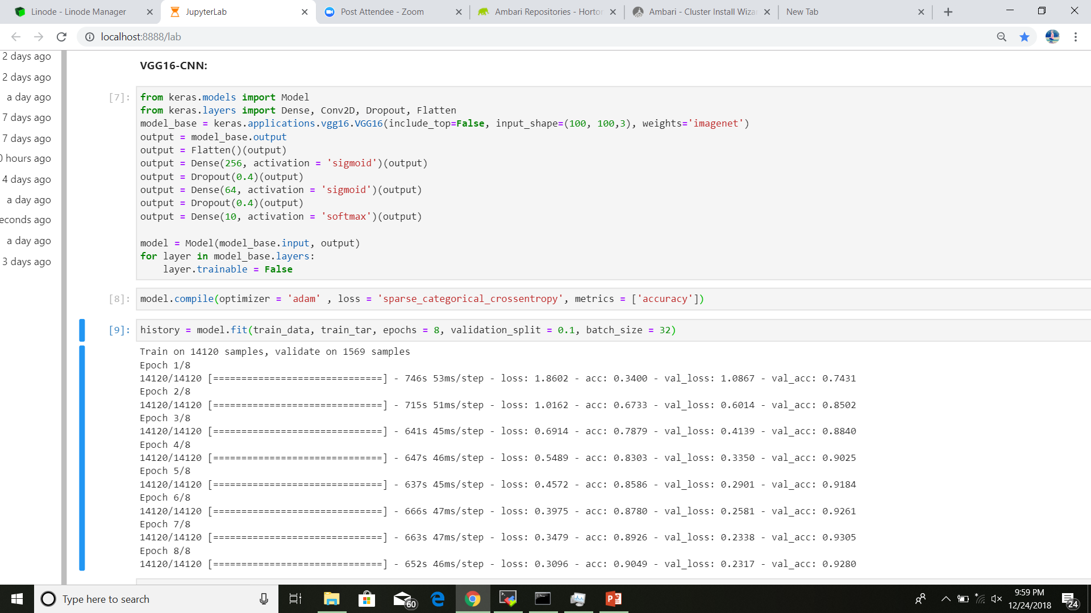
CNN-B Model Training
We split the data into train and test sets, with a test split of 30%.
The loss function minimized is the cross-entropy loss function.
The optimizer used Adam Optimizer, which is an improved version of Vanilla Gradient Descent algorithm, with added variations to overcome the affect of local minima.
While training, we look at the accuracy as a performance metric.
Also, we used 10% of our training set as validation set to see the generalized performance at the end of each epoch.
A batch size of 32 is used in our model.

Slide 40
CNN-B Model Training (contd.)
We trained the model for 8 epochs.
The both the training and validation accuracy improved drastically.
Initial training accuracy: 0.3400
Final training accuracy: 0.9049

Slide 41
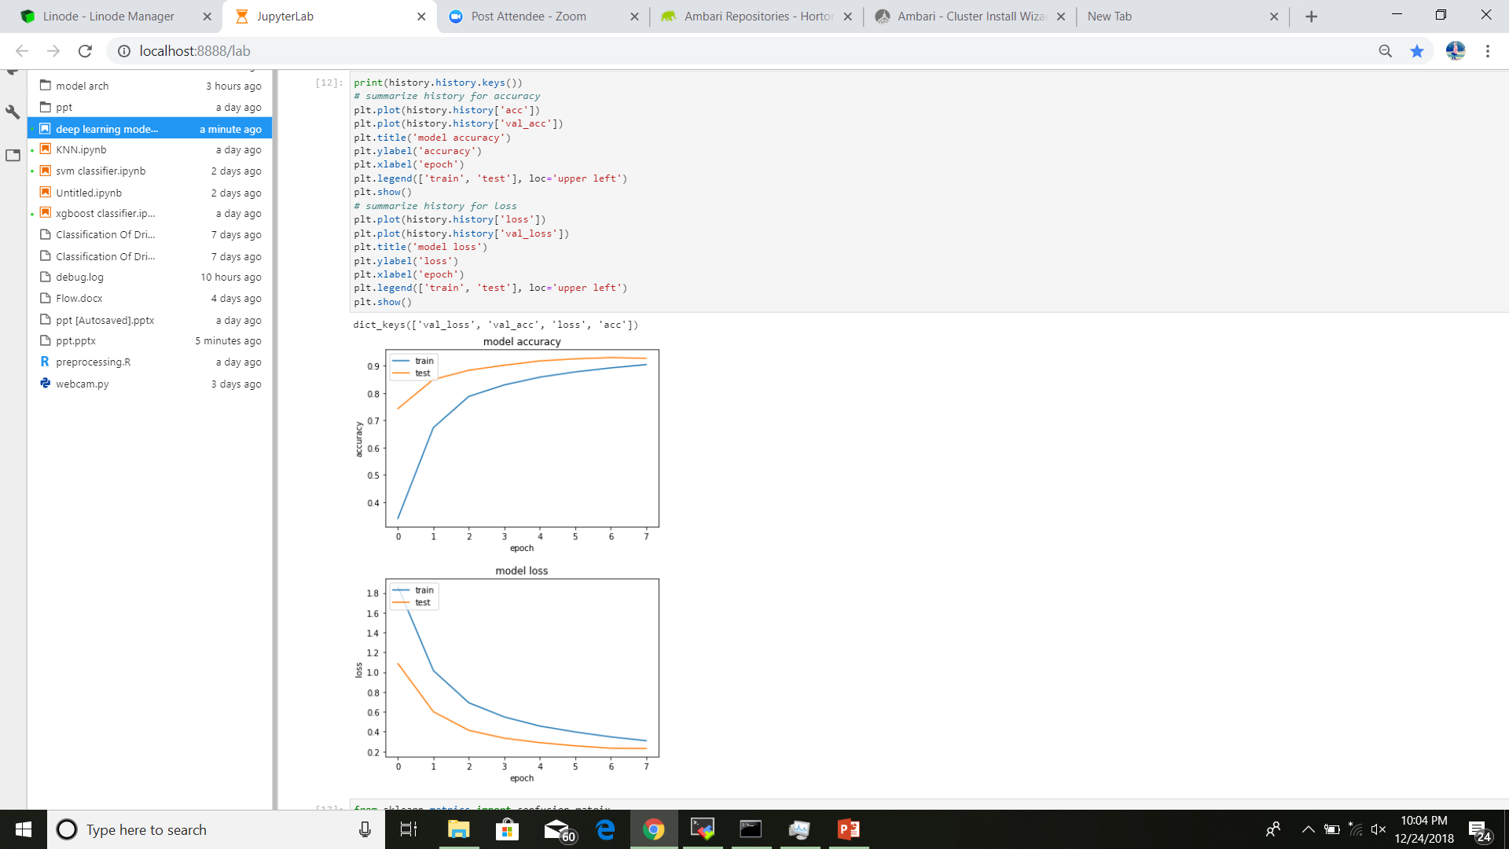
CNN-B Model Training (contd.)
The plots show the variation of accuracy and the loss function with each epoch for the training and the validation set.
The plots clearly show that the model performs very well on the validation set and thus has a higher generalization (test) accuracy and lower generalization loss . This is exactly what we want.

Slide 42
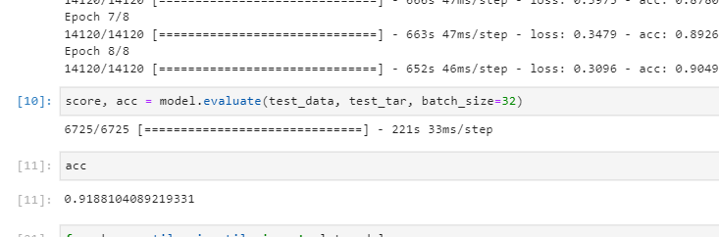
CNN-B Model Evaluation
We evaluate our model on the 30% test set that was split in the beginning. We used the following evaluation metrics:
Test Set Accuracy
Confusion Matrix
Precision, Recall, F1 Score
Area Under the ROC Curve
ACCURACY: We got a 91.88% on the test set. (shown)

Slide 43
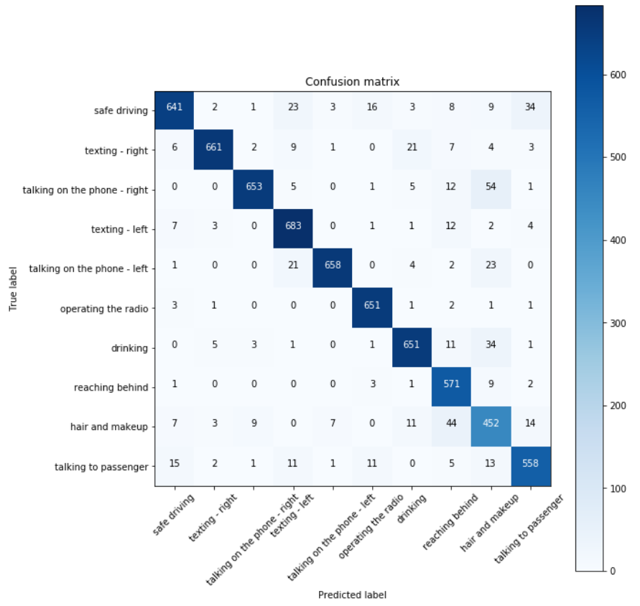
CNN-B Model Evaluation (contd.)
CONFUSION MATRIX: The script and the confusion matrix are as below. As is evident from the diagonal entries of the matrix, most of the predictions done by the model are correct.

Slide 44
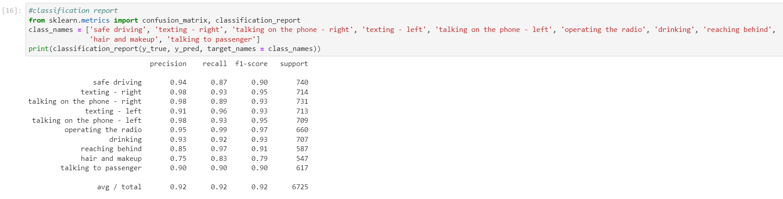
CNN-B Model Evaluation (contd.)
CLASSIFICATION REPORT: For further insights about the model performance, we also found the precision, recall and F1 score for each target class. The script and the model performance as per the metrics is shown below. The model performs pretty good as per the report ☺. Average stats:
Precision: 0.92
Recall: 0.92
F1 Score: 0.92

Slide 45
Long Short Term Memory

Slide 46
LSTM
Although LSTMs are mainly used for time series and sequence data, the architecture seemed to perform unbelievably well on the image classification problem at hand.
For this model, we took the preprocessed images, as returned by the VGG16 model, pre trained on ImageNet. The output of the model, without flattening is of the shape
(3, 3, 512).
For passing the data to the model, we reshaped our images in a 2D sequence form. We reshaped our preprocessed feature maps as returned by the deep conv. net to (9, 512).
These reshaped feature maps were input to the LSTM layer. Each of the 9 rows formed 1 sequence for the layer.
The intuition can be thought of as this way: Since when an image loads, it loads from top to bottom; first the top row pixels load, then next row and so on.
The LSTM model gets 1 row of the feature map as input at a time, which it remembers using its hidden cells until it has seen the whole feature map, after which it makes classification prediction.
The model performs really well and takes comparatively very less time for training.
Each epoch took ~10sec with around 15000 data points, which is very less as compared to the large training time of VGG16 because of its deep structure.

Slide 47
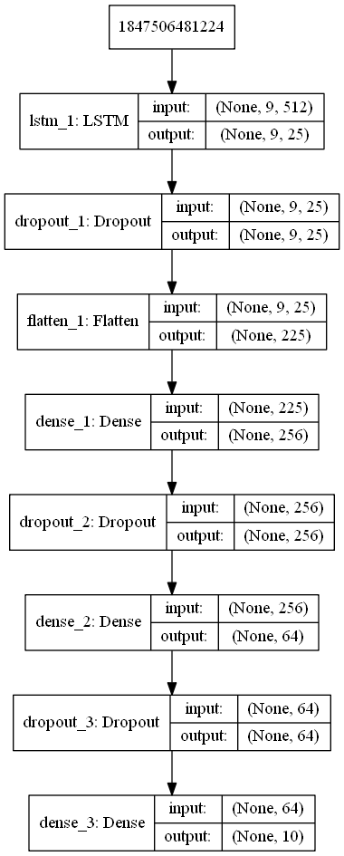
LSTM Architecture
The architecture used had 1 LSTM layers with 25 and 25 neurons respectively.
Dropout layers are added as a measure to avoid overfitting, to meet the overall goal of generalization.
The LSTM layers are followed by the fully connected layers. All the Dense layers use ReLU as the non linear function, except for the last layer which uses the softmax non linearity to produce the final classification output.

Slide 48
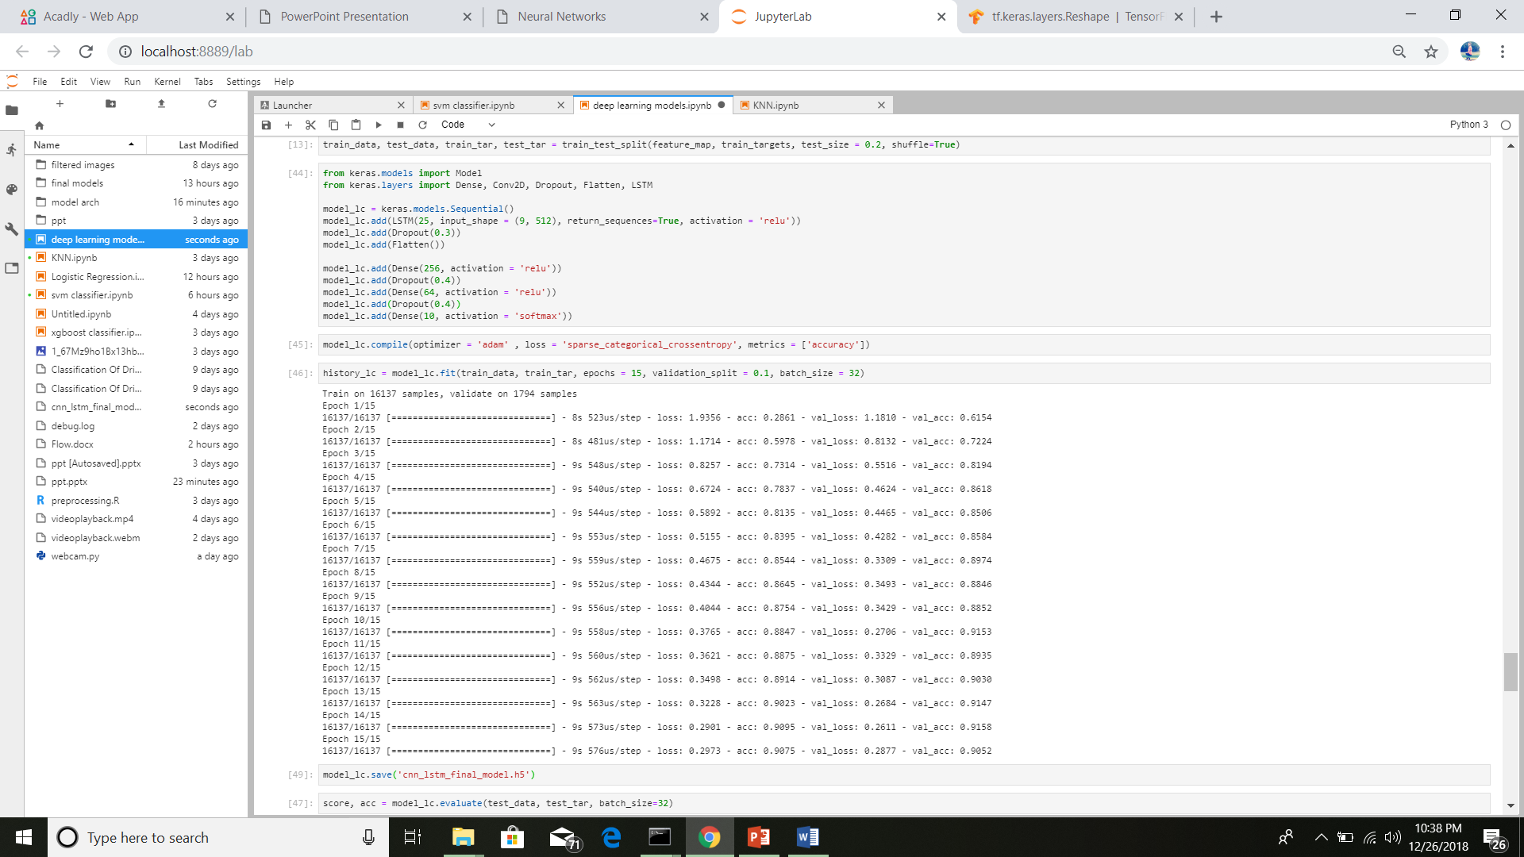
LSTM Model Training
We split the data into train and test sets, with a test split of 30%.
The loss function minimized is the cross-entropy loss function.
The optimizer used Adam Optimizer, which is an improved version of Vanilla Gradient Descent algorithm, with added variations to overcome the affect of local minima.
While training, we look at the accuracy as a performance metric.
Also, we used 10% of our training set as validation set to see the generalized performance at the end of each epoch.
A batch size of 32 is used in our model.

Slide 49
LSTM Model Training (contd.)
We trained the model for 15 epochs.
The both the training and validation accuracy improved drastically.
Initial training accuracy: 0.28
Final training accuracy: 0.907

Slide 50
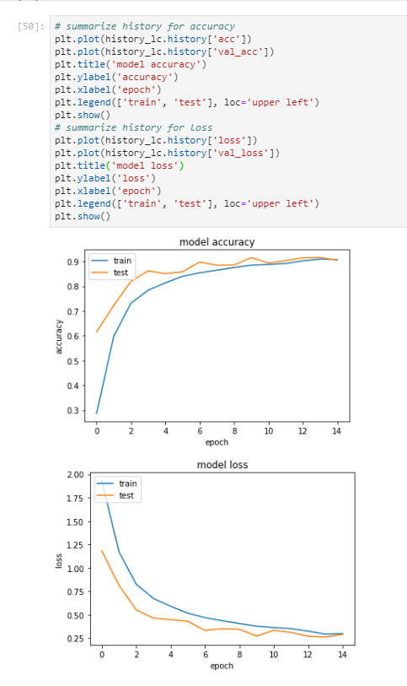
LSTM Model Training (contd.)
The plots show the variation of accuracy and the loss function with each epoch for the training and the validation set.
The plots clearly show that the model performs very well on the validation set and thus has a higher generalization (test) accuracy and lower generalization loss . This is exactly what we want.

Slide 51
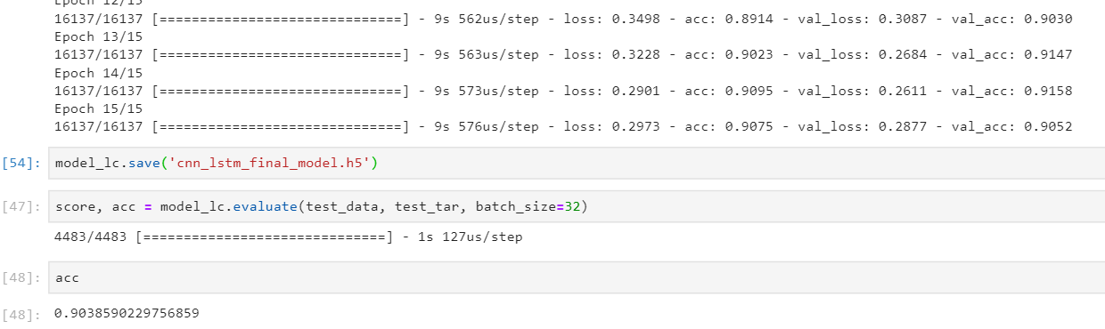
LSTM Model Evaluation
We evaluate our model on the 30% test set that was split in the beginning. We used the following evaluation metrics:
Test Set Accuracy
Confusion Matrix
Precision, Recall, F1 Score
Area Under the ROC Curve
ACCURACY: We got a 95.05% on the test set. (shown)

Slide 52
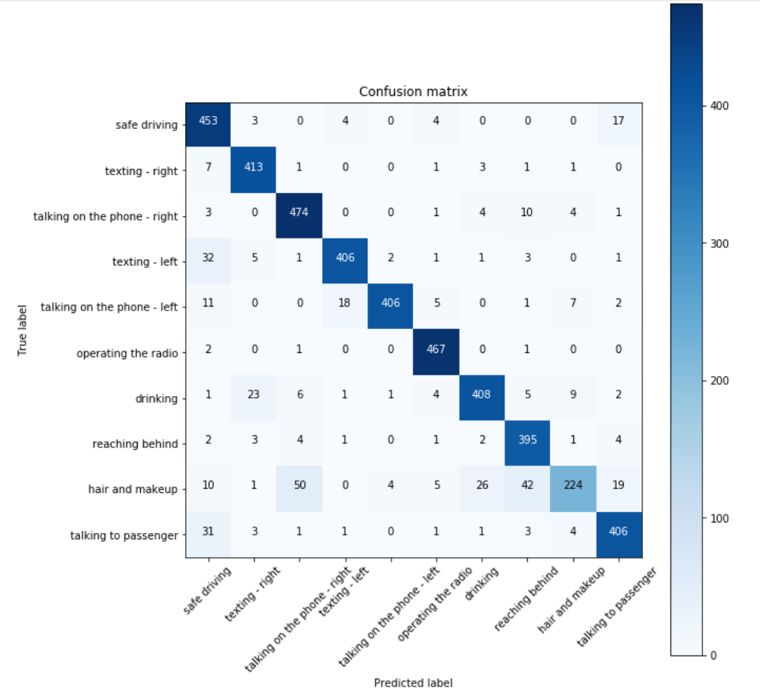
LSTM Model Evaluation (contd.)
CONFUSION MATRIX: The script and the confusion matrix are as below. As is evident from the diagonal entries of the matrix, most of the predictions done by the model are correct.

Slide 53
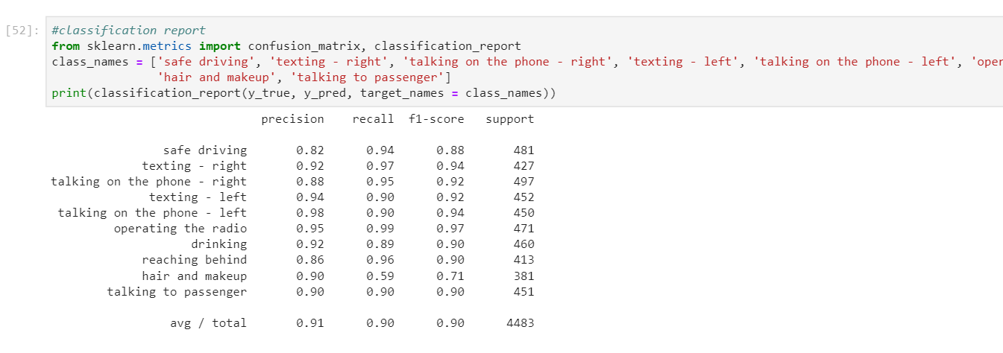
LSTM Model Evaluation (contd.)
CLASSIFICATION REPORT: For further insights about the model performance, we also found the precision, recall and F1 score for each target class. The script and the model performance as per the metrics is shown below. The model performs pretty good as per the report ☺. Average stats:
Precision: 0.95
Recall: 0.95
F1 Score: 0.95

Slide 54
Comparison

Slide 55
Comparative Analysis
Models Paramet- ers | LSTM | CNN (scratch) | CNN (VGG16) | KNN | SVC
Accuracy | 90.01% | 96.70% | 91.88% | 96.45% | 90.54%
Training Time (train size = 14120) | ~2 min | ~60 min (>1hr) | ~86 min (~1.5hrs) | ~zero | ~20 min
Testing Time (train size = 6725) | ~1 sec | ~150 sec | ~221 sec | LARGEST! | ~15sec
BEST
☺
(wrt. TIME)
BEST
☺
(wrt. ACCURACY)

Slide 56
DEM☺

Slide 57
Further Improvements & Scope
The models we have used can be further be analyzed for more hyper parameter tuning.
The deep learning approach for distracted driver detection clearly performs better than any classical technique.
The model can also be deployed to real life devices in automobiles to detect if the driver is distracted for too long, etc.

Slide 58
Thank you!

